Slide 1





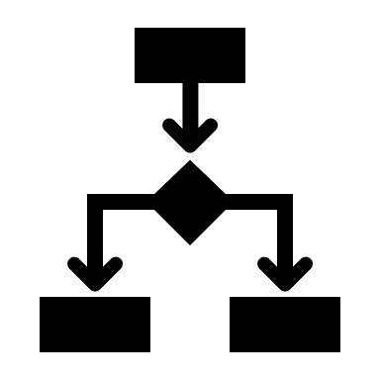


ZERO SHOT LEARNING Architecture on AZURE
Business Intelligence
Legend
Client Engagement
Knowledge Brain: SQL and Neural Networks
Optional
A-I Web Service
Data Factory / Spark
Data Lake/WH
Databricks / Spark
Knowledge Transformation
Azure
Graph DB Connector
Image Source
Image Source
Topic Model
Knowledge Graph DB
DB Source
DB Source
Deep Learning
Graph-Based Hierarchical Clustering
Image Capture Random Field Integrator
AI Services
Cognitive Services
Document Source
Document Source
OCR / GloVe
Machine Learning Studio
Missing Data Services & Anomaly Detection
External Rich Data Source
External Rich Data Source
Keras Deep Learning Framework
Notes:
<number>

Slide 2
Random field integrator implementation on AZURE
Data Lake/WH
Databricks / Spark
Azure
Legend
Local Models
Perform OCR on multiply-rotated image source training files
Extract noisy estimates of image labels from each rotated image
Deep Belief Network (DBN) to learn marginal distribution associated to each character “stream” from each image
Each of the N distributions is an element of a “conditional specification”
Global Model
(Random Field)
DBN to learn global joint probability distribution from N models
Marginal distributions of joint probability distribution match N distributions of conditional specification
Optional
Image Source 1
Image Source 2
Image Source N
Notes:
<number>

Slide 3
Image source Tokenizer implementation on AZURE
Databricks / Spark
Azure
Label and Medication Info Extraction
Tokenizer
OCR-extracted image labels from rotated images consist of a list of character sequences
Tokens (contiguous character sequences) are converted to integer sequences
Integer sequences are padded to produce a tensor of shape (num_samples,num_timesteps)
Random Field Models from DBN
Local models are produced for each “word” (character sequence) in each detailed level giving “word”-”word” co-occurrence marginal distributions
DBN to learn global distribution of “word”-”word” co-occurrences from marginals
Marginals of global distribution are elements in conditional specification
Global distribution identifies “word” associated to each specific marginal
Legend
Optional
Direct Images from Local Files and Remote URLs
Direct Images from Local and Remote DBs
Embedded Images in Local Files and Remote URLs
External Medication Info
Notes:
<number>

Slide 4
transformation, cleansing and expansion implementation on AZURE
Data Lake/WH
Databricks / Spark
Azure
OCR
GloVe for Data Expansion
Distributions of word-word co-occurrences from pre-trained GloVe model
Marginals in chosen GloVe model detail distribution of all other words with given word
DBN to learn global distribution of word-word co-occurrences from marginals
Marginals of global distribution are elements in conditional specification
Global distribution identifies word associated to each specific marginal
Expanded data set gives more detailed insights into extracted labels
Legend
Optional
Image Source
DB Source
Document Source
Missing Data Services
DBN for character-based data correction activities
External Rich Data Source
Notes:
<number>

Slide 5
Knowledge graph implementation on AZURE
Databricks / Spark
Cosmos DB
Azure
Rotated Image Label Character Streams
Knowledge “Brains”
DBN for hierarchical clustering of threat vector data streams
Expanded data are properties of identified image labels in each leaf of the hierarchy
Each leaf in the child hierarchy defines a distribution in the conditional specification of the global distribution top leaf
Each subset of all columns as the data set in the top leaf leads to a hierarchy that defines a “brain”
Knowledge Graphs and A-I Service
Each knowledge “brain” forms a separate graph when each 2 labels in a leaf node connect to form an edge in the graph
Properties give additional details about each label and allow the labels to be searched via SQL statements
Each leaf defines ranges for each property, so-called association rules
A-I service can be implemented as an OCR and SQL call on the properties of a particular “brain” and associated leaf with its conditional distribution
Image labels are predicted from extracted text using pretrained OCR and a pretrained DBN (zero-shot)
Legend
Optional
Transformed, Cleaned and Expanded Data
Notes:
<number>

